Slide 1
Business Programming
Lesson 1

Slide 2
Understanding software development methodologies
Duration : 2 Hours
Period : Week 3 Day 1

Slide 3
Learning Outcomes:
By the end of the lesson, students ,must be able to:
Explain the term system
Differentiate system from information systems.
Identify different types of systems found in an organization
Explain the concept of software development methodologies
What is meant by the term application management?
Identify different software methodologies
Recap
Notes:
Tip: Add your own speaker notes here.

Slide 4

Introduction-[Systems]
Difference between system and information system
A System is set of related components that produces specific results
Information system is a system that combines information technology, people, and data to support business requirements
Notes:
A system is made up of :
Machines,
People
Processes and Methods
Software

Slide 5
A Bit of History…
1950s: focus on efficient automation of existing processes
1960s: advent of 3GL, faster and more reliable computers
1970s: system development becomes more like an engineering discipline
1980s: major breakthrough with 4GL, CASE tools, object oriented methods
1990s: focus on system integration, GUI applications, client/server platforms, Internet
The new century: Web application development, wireless PDAs, component-based applications
Notes:
This coincides with the generation of languages.

Slide 6
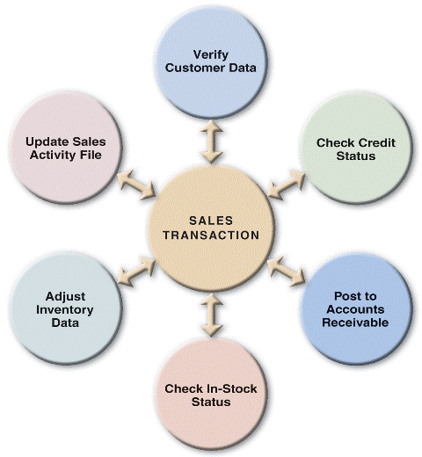
[Types of Systems]
[Types of Systems]
Use of different references
Get different discussion on types of systems
Examples of different systems are important

Slide 7
System development vs Software development
A system development methodology refers to the framework that is used to structure, plan and control the process of developing an information system.
Software development is the process of conceiving, specifying,designing, programming, documenting, testing, and bug fixing involved in creating and maintaining applications, frameworks, or other software components.
Notes:
Systems development is mainly guided by the analyst and designer
Software development is guided by developers or analyst programmers
A methodology is, a set of steps, guidelines, activities and/or principles to follow in a particular situation.
Most methodologies are comprehensive, multi-step approaches to systems development

Slide 8
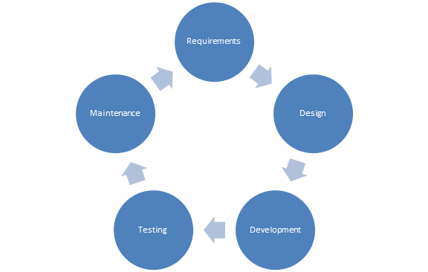
Application Lifecycle Management (ALM)
Application lifecycle management (ALM) is the set of activities that revolve around a new software product, from its inception to when the product matures.
Notes:
Tip: Add your own speaker notes here.

Slide 9
Requirements
Requirements analysis is the process of determining the detailed business requirements for a new software system.
A business analyst is responsible for analyzing business needs and converting them into requirements that can be executed by the development team.
Notes:
Tip: Add your own speaker notes here.

Slide 10
Design
The design activity is used to create plans, models, and architecture for how the software will be implemented.
Participants
Architect
User-experience Designer
Notes:
Tip: Add your own speaker notes here.

Slide 11
Development
The software development activity involves implementing design by creating software code, databases, and other related content.
Participants
Developers
Database Administrators (DBAs)
Technical Writers
Content Developers
Notes:
Tip: Add your own speaker notes here.

Slide 12
Testing
Testing is used to assure the quality of the final product.
What will happen if software testing is not done?
Notes:
Tip: Add your own speIdentifies possible gaps between the system expectations described in the requirements document and actual system behavior.
Participants
Testers
aker notes here.

Slide 13
Understanding Testing
Software testing is the process of verifying software against its requirements.
Notes:
Tip: Add your ownSoftware testing can only help find defects—it cannot guarantee the absence of defects.
It is much more cost-effective to find defects earlier (rather than later) in the product development cycle.
speaker notes here.

Slide 14
Testing Methods
Black-box Testing
White-box Testing
Notes:
Black-box Testing
Focusing solely on inputs and outputs.
Any knowledge of internal system workings is not used for testing.
Is used to make sure a software application covers all its requirements.
White-box Testing
Testers use their knowledge of system internals when testing the system.
Is used to make sure that each method or function has proper test cases available.

Slide 15
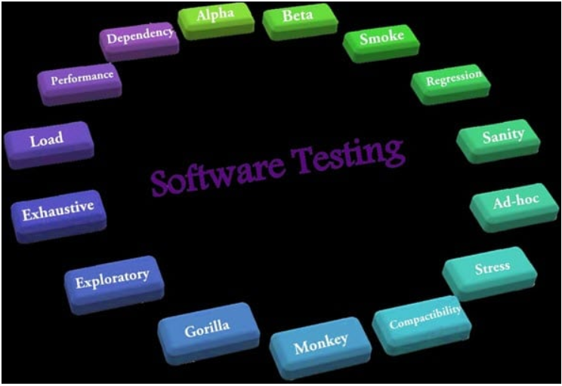
Software Testing
Notes:
There are several testing methods implemented to software programs. the purpose of software testing is to make sure that software meets user reqyuirements and also deal with possible break up after full implementation. Some of the software tests highlighted on the diagram are not discussed in this presentation. In groups you are required too discuss these in detail

Slide 16
Testing Levels
Unit Testing
Integration Testing
System Testing
Regression Testing
Notes:
Unit Testing
Verifies the functionality of a unit of code.
Integration Testing
Assesses the interface between software components.
System Testing
Overall testing of the software system.
Regression Testing
Makes sure that each new fix doesn’t break anything that was previously working.

Slide 17
Criteria for choosing methodology
Process oriented approaches
Data-oriented approaches
Object Oriented Approaches
Network Model
Notes:
Process oriented-Look at all of our processes. Processes take precedence over data. Get the processes correct first. Worry about the data after
Data oriented-Forget the processes, look at the data. Data comes first, get the data correct. Once the data have been defined correctly, look at how the processes actually use the data

Slide 18
Roles of a Methodology
Specify what tasks need to be completed
Specify what deliverables should be created
Specify whom should be included
Notes:
The methodology must be able to specify what tasks needs to be completed, the deliverables and whom should be included.

Slide 19
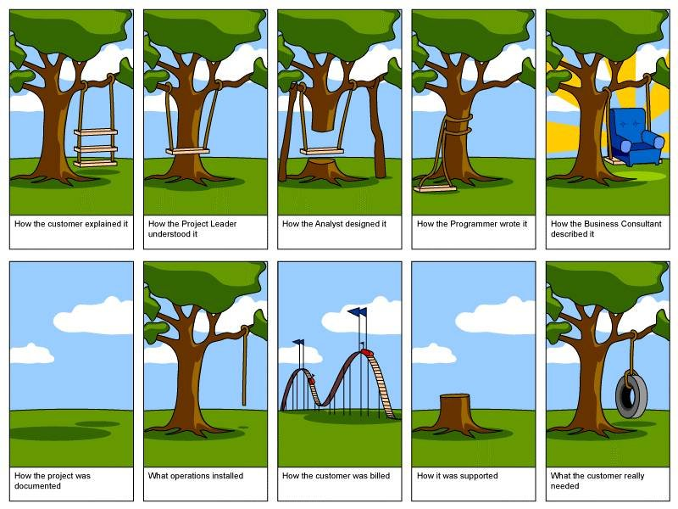

Slide 20
Types of software development methodologies
Software Development Lifecycle (SDLC)- Waterfall & V Model
Prototyping
Incremental
Spiral
Rapid Application Development
Agile methodologies
Notes:
The slide provides a list of different software methodologies. A broad overview of the methodologies is given in the preceding slides. The next lesson will explain in detail the different agile methodologies .

Slide 21
Systems Development Life Cycle
Every methodology has roughly the same stages
Usually they stages are
Project Identification and Selection
Project Initiation and Planning (just after Conception)
Analysis
Design
Implementation
Maintenance (starting Maturity)
1.‹#›
Notes:
Predictive approach
Uses a set of process models to describe a system graphically
Process-centered technique
Different types of SDLC
Waterfall method
V model
Why used together

Slide 22
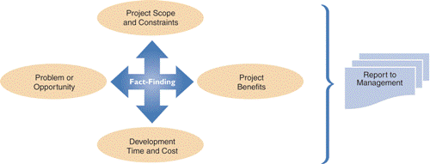
Preliminary investigation process
Why is it important?
Notes:
Preliminary investigation process
Interaction with stakeholders
Planning the preliminary investigation
Six steps
Scope
Business case
Why?

Slide 23
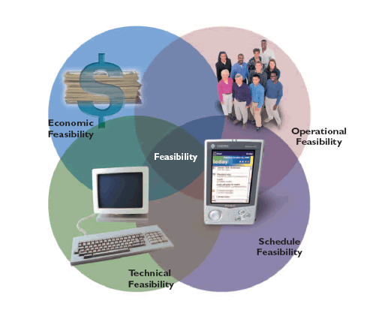

Feasibility Stage
Project feasibility
Why?
Measuring of feasibility
Planning feasibility
Notes:
Feasibility refers to how doable the project is. Feasibility encompasses operational, economic, time, management political, technical, social dimensions and many others.

Slide 24
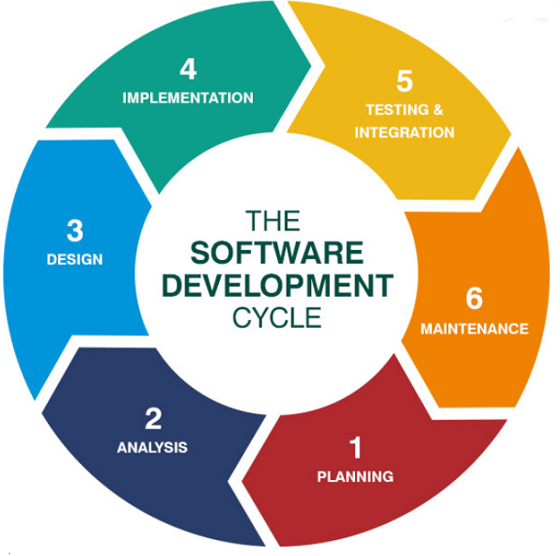
SDLC STAGES
Notes:
The image shows typical stages od SDLC. Some give them different names but ultimately what is done at each of the stages is the same

Slide 25
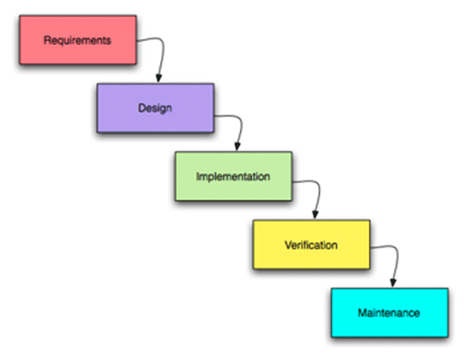
Waterfall Approach
This approach essentially refers to a linear sequence of stages to develop a system from planning to analysis to design to implementation.
Stages are followed from beginning to end.
Revisiting prior stages is not permitted.
Notes:
The only difference with SDLC is that the next stage can be started halfway through the middle of the previous stage.

Slide 26
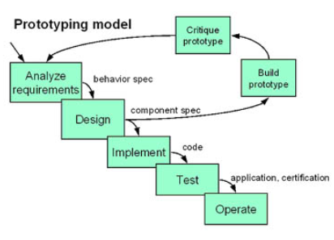
Prototyping
Is an iterative methodology
Speeds up the development process significantly
Important decisions might be made too early, before business or IT issues are thoroughly understood
Can be an extremely valuable tool
Notes:
Prototyping
Building a scaled-down working version of the system
Advantages:
Users are involved in design
Captures requirements in concrete form

Slide 27
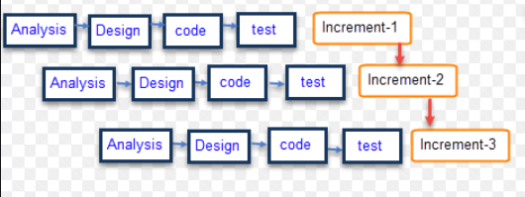
Incremental methodologies
The incremental build model is a method of software development where the model is designed, implemented and tested incrementally (a little more is added each time) until the product is finished.
Notes:
Incremental It involves both development and maintenance. The product is defined as finished when it satisfies all of its requirements.
This model combines the elements of the waterfall model with the iterative philosophy of prototyping.
The product is decomposed into a number of components, each of which are designed and built separately (termed as builds).
Each component is delivered to the client when it is complete. This allows partial utilisation of product and avoids a long development time.

Slide 28
Difference between incremental and Iterative
The Incremental Approach uses a set number of steps and development goes from start to finish in a linear path of progression.
The Iterative Approach has no set number of steps, rather development is done in cycles.
Notes:
Incremental development is done in steps from design, implementation, testing/verification, maintenance.
These can be broken down further into sub-steps but most incremental models follow that same pattern.
The Waterfall Model is a traditional incremental development approach.
Iterative development is less concerned with tracking the progress of individual features.

Slide 29
Spiral development methodology
Combination of waterfall methodology and prototyping methodologies
Combination of the top-down and bottom up concepts
Primary focus is on risk assessment
Break the project into smaller segments
Controls the impact of change

Slide 30
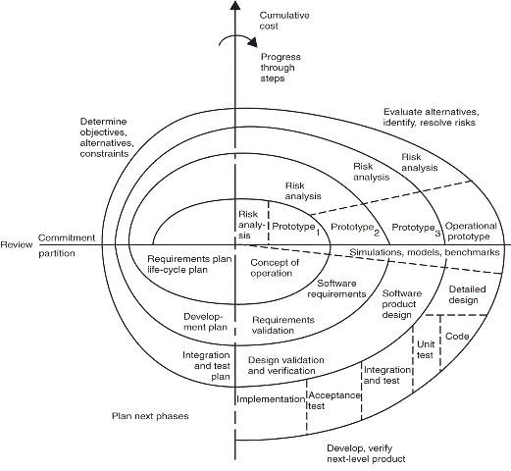
System Development Life Cycle [SDLC]
Notes:
Each cycle includes the same stages
As identified in SDLC model
Each cycle includes
Determine objectives, alternatives and constraints
Evaluate alternatives and resolve risks
Develop and verify deliverables
Plan the next iteration

Slide 31
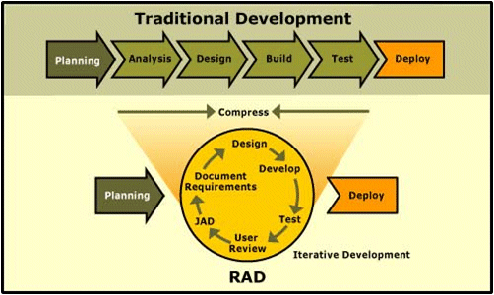
Rapid Application Development (RAD)
Is an iterative process. Systems are developed within a short space of time. Best used in cases where a new system is needed urgently.
Notes:
Key objective is for fast development and delivery of a high quality system at a relatively low investment cost.
Attempts to reduce inherent project risks by breaking a project into smaller segments and providing more ease of change during the development process.
Key emphasis is on fulfilling the business need while technological or engineering excellence is of lesser importance.

Slide 32
Agile methodologies
Agile is a process that helps teams provide quick and unpredictable responses to the feedback they receive on their project.
It creates opportunities to assess a project’s direction during the development cycle. Teams assess the project in regular meetings called sprints or iterations.
Notes:
AGILE advocates to minimize documentation task and invest more time on core development activity, however the degree of documentation differ in different approaches. –Add your own speaker notes here. A lot of different methodologies are followed in AGILE. All of them are similar to each other but there are also some differences amongst those.

Slide 33
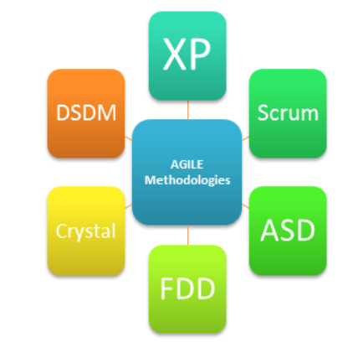
Key methodologies in Agile
Xtreme Programming (XP)
SCRUM
Agile Software Development (ASD)
Feature-Driven Development(FDD)
Crystal Methods
Dynamic Systems Development Method (DSDM)
Notes:
XP (Xtreme Programming), Scrum, ASD (Agile software development) & Crystal don’t put a lot of emphasis on documentation and minimum documents are created
Teams following FDD spend sufficient amount of time in documentation.
DSDM requires some documents to be created & degree of documentation is less than that of FDD and more than that of XP

Slide 34
Summary
Information system methodologies are used to guide the development of information systems
The SDLC is seen as the starting point from which many alternative methodologies have developed
Since the SDLC many alternatives have been developed and used, such as JAD and RAD
There are probably thousands of methodologies now!
***

Slide 35

System development guidelines
Stick to a plan
Involve the users throughout the development process
Listening is very important
Use project management tools to identify tasks and milestones
Remain flexible
Develop accurate cost and benefit information

Slide 36
More
Where to find more Questions and Answers
Textbook
Internet
Other Systems Analysis and Design Textbooks

Slide 37
Questions?
?

